Slide 1

Socioeconomic Vulnerability Index For Adaptation to Rising Seas
Team SOVIARS
6th May 2025

Slide 2
Team Members
Akarsh Matlaparthi Scrum Master
Charan Reddy Tamma Developer
Manikanteswar Gandrothula Developer
Pooja Vemuri Product Owner
Venkata Naga Sanjay Reddy Narra Developer
Abhista Chidamber Atchutuni Developer

Slide 3


Client Introduction
The Puerto Rico Science, Technology, and Research Trust is a private non-profit organization established in 2004 to foster innovation, technology transfer, commercialization, and job creation in Puerto Rico's technology sector. Based in San Juan, the Trust plays a crucial role in shaping public policy related to science, technology, research, and development.
The Trust actively supports technology-driven startups by providing funding and assisting inventors in securing patents. Additionally, its Technology Transfer Office, led by David Gulley (as of 2019), focuses on monetizing scientific advancements to drive Puerto Rico's economic growth.

Slide 4
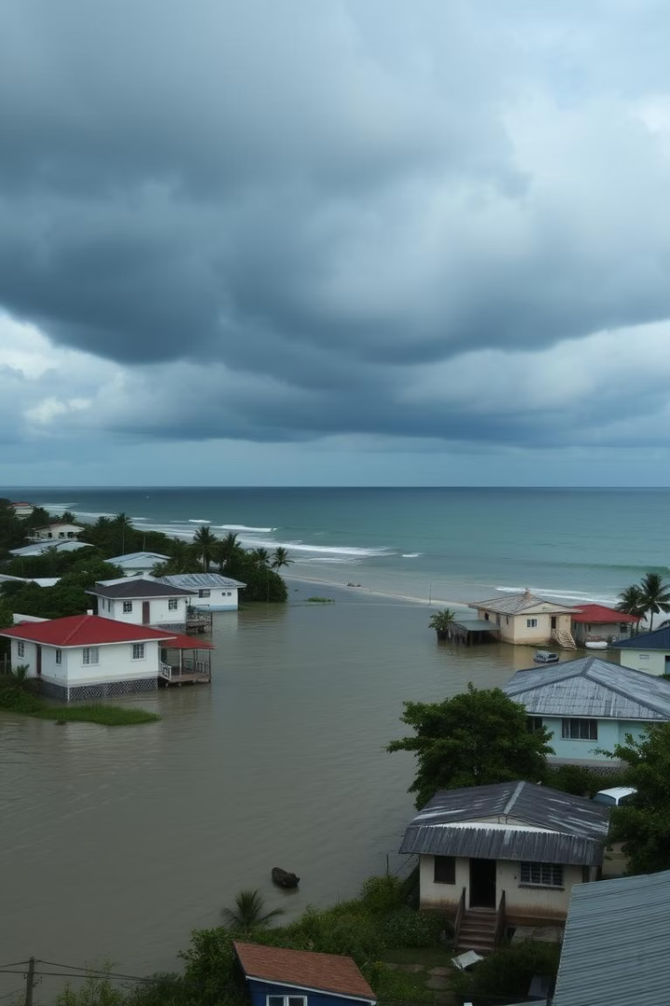
Problem Statement
DOMAIN OF THE PROBLEM: Impact Of Climate Change
KEY CLARIFICATIONS
Greater focus on weighting socioeconomic conditions, usability for policymakers, and adaptability for future data updates.
Develop a data-driven vulnerability index that integrates socioeconomic factors (income, education, employment) with environmental risks (flooding, seal-level rise) to assess and prioritize at-risk communities.
IMPORTANCE OF THE PROBLEM
Project include the increased risk and severity of adverse outcomes for communities facing climate change induced hazards like flooding, erosion, and storm surges. Without a comprehensive and data-driven assessment tool, at-risk communities may be overlooked in resource allocation, leading to exacerbated socioeconomic disparities and reduced resilience against environmental threats​

Slide 5





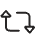


Project Goals
Primary Goal
Develop a data-driven vulnerability index for Puerto Rico
Create Visualizations
Communicate findings to policymakers and public
Provide Framework
Enable local updates as new data becomes available
Highlight Data Gaps
Guide future research for climate adaptation planning
Develop a data-driven index tailored to Puerto Rico that evaluates vulnerability to rising seas by giving a larger weight to socioeconomic vulnerability. The index must integrate key variables, such as socioeconomic disadvantages, short and medium-term exposure to permanent flooding, storm surges, and coastal erosion.

Slide 6






Data Collection & Cleaning
Sources
Social Dataset
U.S. Census Bureau (ACS 2023 5-Year Estimates), FEMA NFHL, NOAA DEM, QGIS and data cleaning is done through using excel, python and QGIS software.
This dataset comprises columns related to household structure, disabilities, education, and digital access. It provides insights into social support needs, caregiving responsibilities, communication barriers, and general social vulnerability.
Economic Dataset
Housing Dataset
This dataset includes variables like poverty level, unemployment rate, and median household income. These indicators highlight economic instability and the financial resilience of municipalities.
This dataset contains housing structure details including ownership, age of housing units, and infrastructure access like vehicles and phones. It reflects the stability and resource accessibility within residential environments.
Demographic Dataset
Physical Exposure Dataset
This dataset provides age, gender, and racial composition of the population. It helps identify vulnerable groups such as very young, elderly, or historically marginalized communities.
The dataset focuses on exposure-based risk, combining geographic and demographic vulnerability to sea-level rise and flood zones. It contains data on population living below 7 feet elevation, percentage of area in FEMA flood zones, and population density within flood-exposed areas.

Slide 7


Index Calculation and Methodology
Select Variables Choose indicators from relevant domains (e.g., Social, Economic, Demographic, Housing).
Clean the Data Handle missing values, drop irrelevant columns, and ensure consistent formats.
Normalize the Data Rescale variables to a common range using Min-Max Normalization (0 to 1), so they are comparable.
Assign Weights Give more importance to critical variables or domains based on relevance or expert input.
Create Sub-Indices Group variables by domain and compute weighted sub-index scores (e.g., Social Index).
Calculate Final Index Combine sub-indices using a weighted average to get the final index score (e.g., SoVI).
Categorize Scores Classify results into categories like Low, Medium, High using quantiles or fixed thresholds.
Visualize Present results through charts, maps, or dashboards for easy interpretation.

Slide 8




SOVI Index and Weights
Social Vulnerability Index (SOVI) quantifies community vulnerability by integrating social, economic, demographic, and housing factors. It helps identify high-risk municipalities and supports data-driven resilience planning and resource allocation.
Male HH with Kids – 10%
Female HH with Kids – 15%
Economic (30%)
Social (35%)
HS Graduation – 10%
Poverty Rate – 60%
Disability <18 – 10%
Unemployment Rate – 40%
Disability 18–64 – 15%
Disability 65+ – 20%
Broadband Access – 20%
Housing (15%)
Demographic (20%)
Total Housing Units – 10%
Male – 5%
Built Before 1980 – 15%
Female – 15%
Owner-Occupied – 5%
Under 5 Years – 30%
Renter-Occupied – 30%
65+ Years – 30%
No Vehicle – 25%
Black or African American –20%
No Phone – 15%

Slide 9
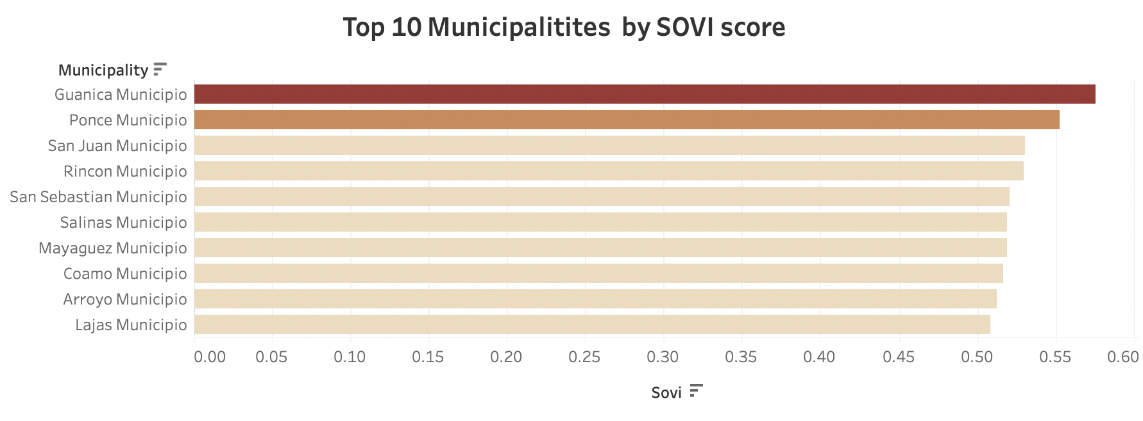
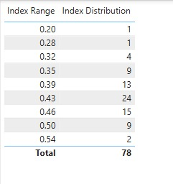
SOVI Index

Slide 10
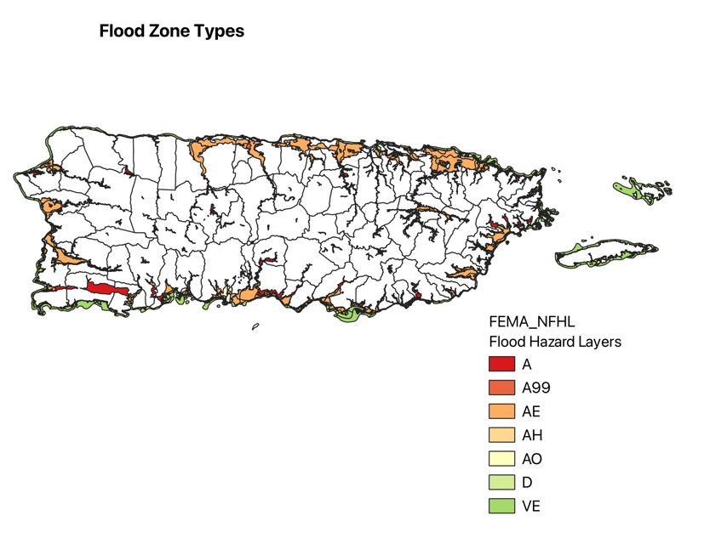
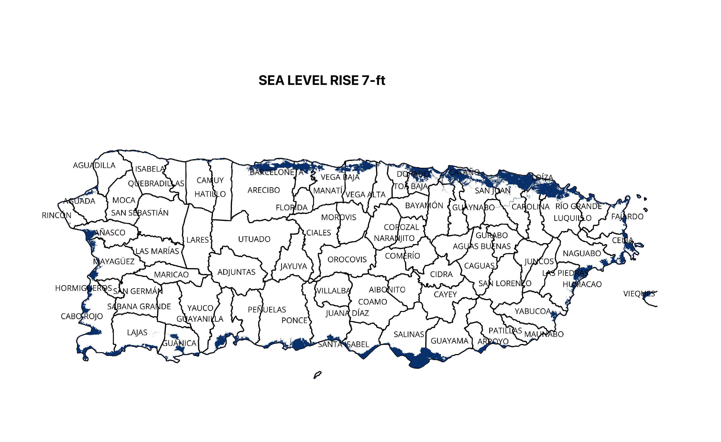
VULNERABILITY TO RISING SEAS(VRS)

Slide 11
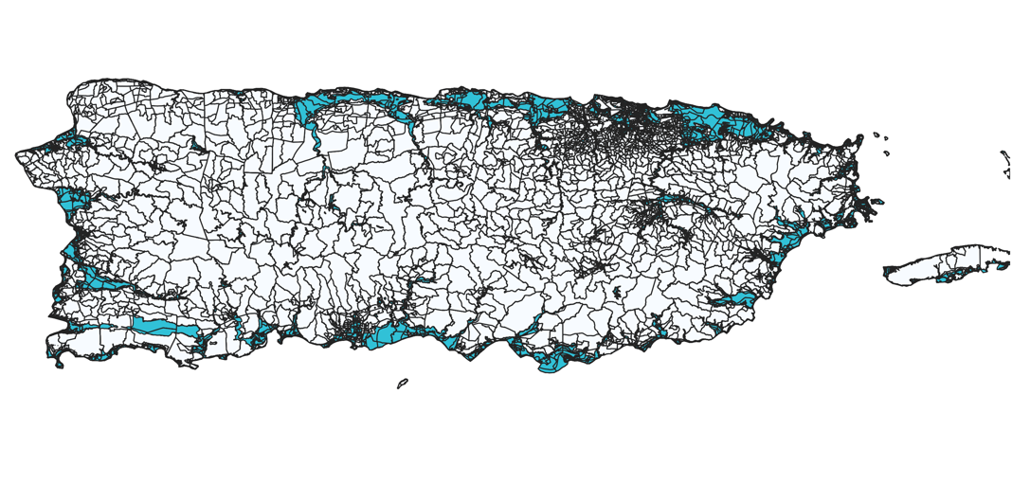
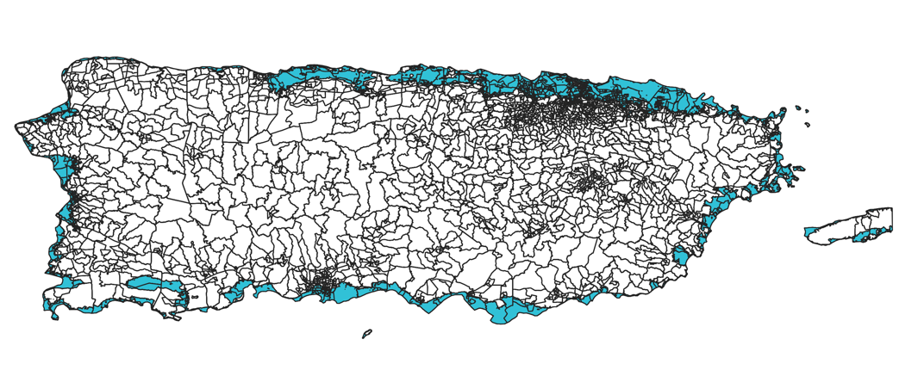
Physical Exposure Data (Block Group Level)

Slide 12
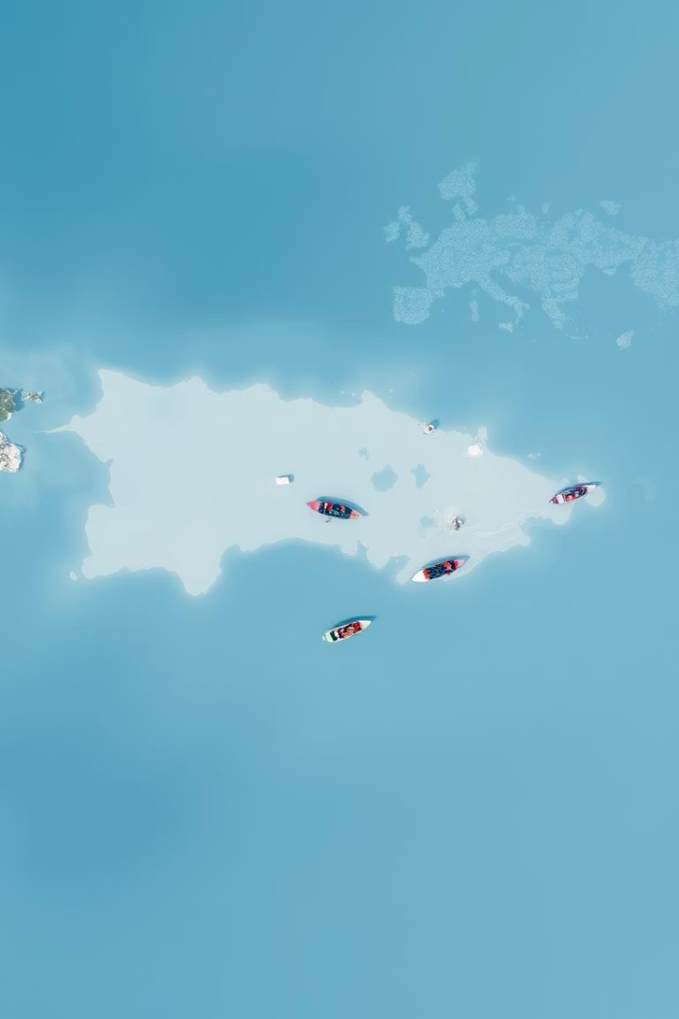
VRS Index and Weights
The VRS Index measures how physically exposed a municipality is to coastal hazards like sea-level rise and flooding. It combines data on elevation, flood zones, and population density to identify areas at greatest environmental risk.
Factor
Description
Weight
%PerPopSLR
Population in areas affected by sea level rise (7 ft)
0.44
%PerPopFlood
Population in FEMA-designated flood zones
0.3
%PerAreaSLR
Area at or below 7 ft elevation
0.18
%PerAreaFlood
Area within FEMA-defined flood zones
0.08

Slide 13
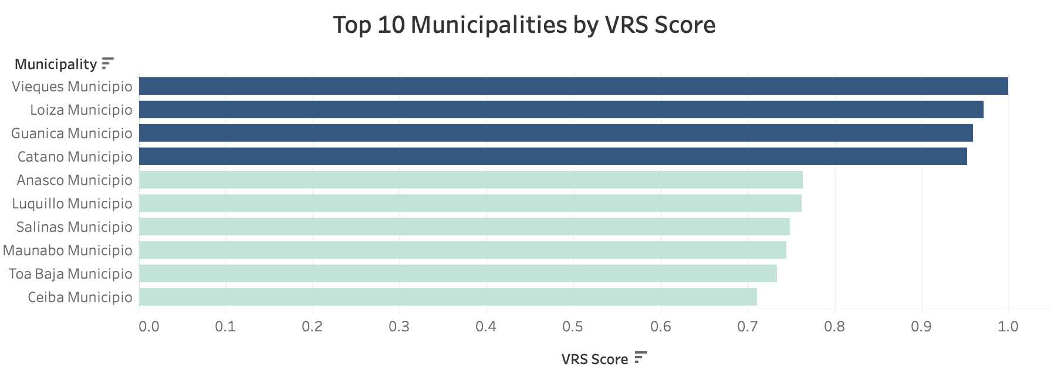
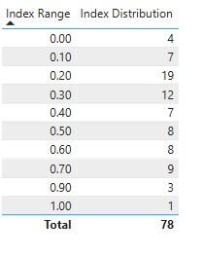
VRS INDEX

Slide 14




SOVIARS Index and Weights
SoVI (60%)
Captures social challenges such as poverty, housing insecurity, and elderly populations
VRS (40%)
Measures physical exposure to sea-level rise and flood-prone areas
SOVIARS Score
Identifies municipalities where people are not only at risk from the environment, but also lack the resources to respond
Use Case Example
A coastal town may be flood-prone (high VRS), but if it also struggles with poor infrastructure and limited healthcare (high SoVI), SOVIARS ensures it's not overlooked in adaptation plans
The SOVIARS Index(Socioeconomic Vulnerability Index for Adaptation to Rising Seas) is a powerful tool designed to capture the full picture of climate risk in Puerto Rico — by combining both social vulnerability and physical exposure to rising seas.
This index supports data-informed decision-making, helping governments and planners prioritize funding, build resilience, and ensure no vulnerable community is left behind.

Slide 15
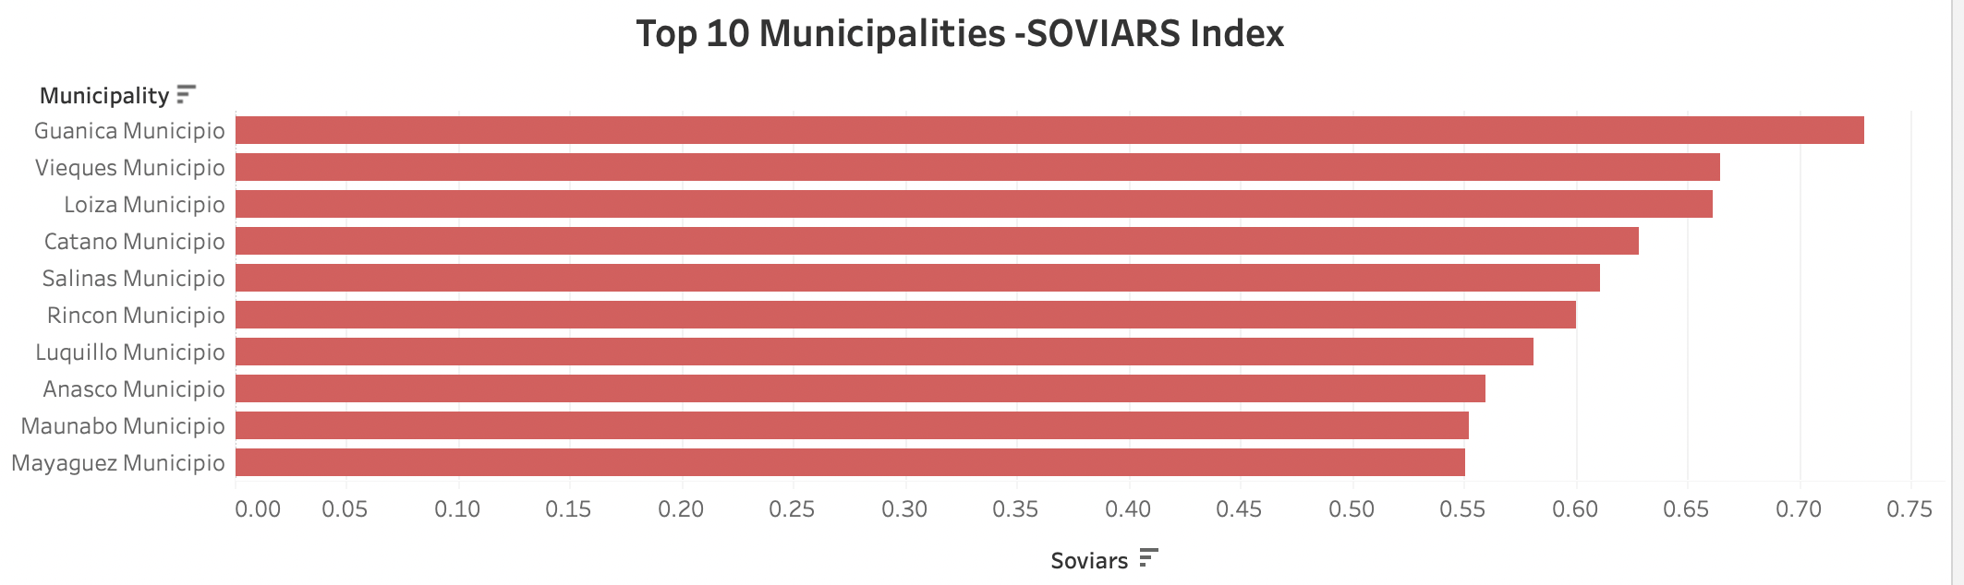
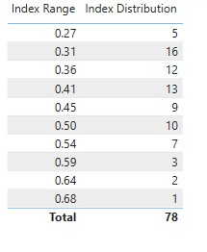
SOVIARS Index

Slide 16

RISK CATEGORIZATION AND ADAPTION INSIGHTS TOOL TIP
The two logic fields that we have integrated into the dashboard are
1. Risk Categories
Adaptive (≤ 0.35): Low overall risk
Vulnerable (0.351–0.50): Moderate combined risk
Highly At-Risk (> 0.50): High social + environmental vulnerability
2.Adaptation Insight (Definition + Highlights) Definition:
Adaptation Insight offers a brief explanation of the underlying cause of a
municipality’s risk and guides the type of action that might be appropriate.
Examples:
Indicates whether risk is driven by social or physical conditions
Helps guide interventions like infrastructure investment or social programming
Provides context without revealing technical calculations

Slide 17
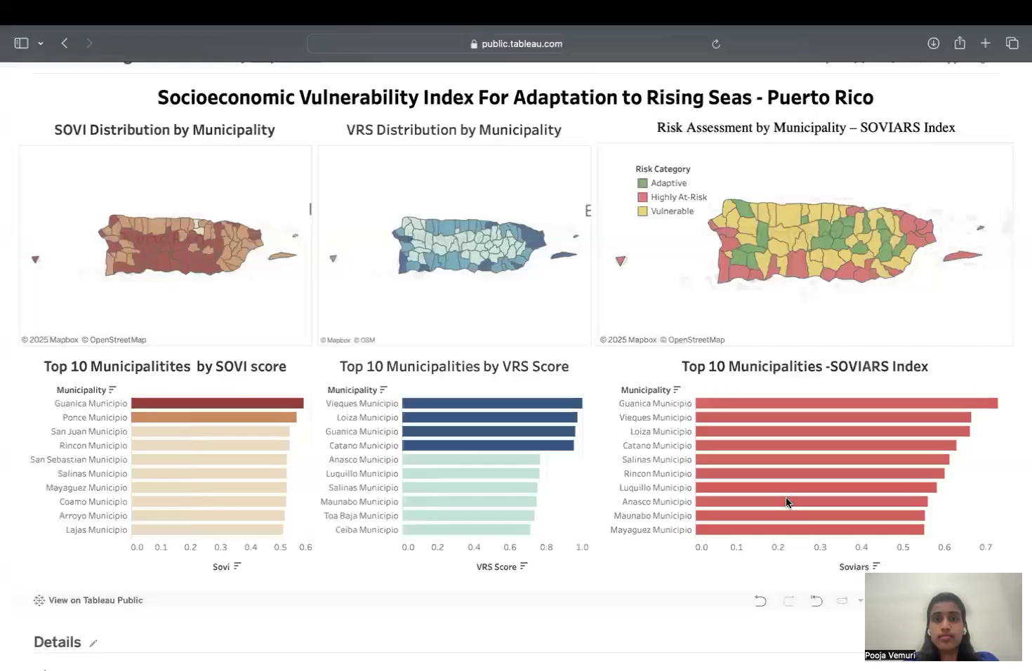
Dashboard

Slide 18
Insights from the Dashboard
1
2
3
Risk Classification+
Recommendation
Guanica at Critical Risk
Varied Risk Profiles
Appears in the top 3 for SoVI, VRS, and SOVIARS
Vieques and Loiza: High physical exposure, but lower social vulnerability
SOVIARS color-coded map offers a clear guide for resource prioritization and foremost action to be taken.
1. Guanica is at critical risk across all dimensions - High vulnerability + high exposure = critical for urgent adaptation planning. Guanica ranks top in all indices — a high priority for multi-layered intervention.
2. Not all high-risk areas are socially vulnerable - These areas face geographic threats more than socioeconomic ones.
3. SOVIARS Map Categorization (Red-Yellow-Green) - Offers a clear risk-based classification.
🔴 Highly At-Risk zones need immediate attention.
🟡 Vulnerable zones should be monitored closely.
🟢 Adaptive zones are relatively resilient.
Recommendation filed suggests what type of intervention may be most appriopriate.

Slide 19

Future Work/Scope
Increase spatial granularity by developing the index at neighborhood or sub-municipality levels to improve targeting accuracy.
Incorporate infrastructure layers like hospitals, roads, and emergency shelters to assess preparedness gaps.
Incorporate proximity metrics to identify nearest adaptation zones and optimize evacuation and support planning.
Predict population and infrastructure trends using machine learning to support dynamic risk forecasting and resource allocation.

Slide 20
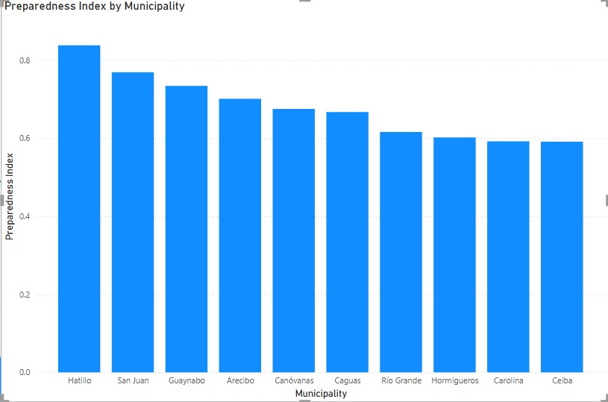
Preparedness Index
The Readiness Index evaluates a community’s capacity to respond to and recover from coastal hazards like sea level rise, storms, and flooding.
In Puerto Rico, it captures the availability and accessibility of critical infrastructure—such as shelters, schools, community centers,
transportation hubs, and government buildings. This index helps identify how well-equipped each municipality or sub-region is to support
emergency response and long-term resilience.
Facilities Considered & Assigned Weights
Facility | Weight
Shelters | 0.30
Hospitals | 0.25
Community Centers | 0.15
Schools | 0.10
Government Buildings | 0.10
Transportation Hubs | 0.10

Slide 21


